Slide 1
Transition to Open Science
Frank Miedema
Vice Rector Research, Utrecht University
Chair UU Open Science Program
Twitter @MiedemaF; www.scienceintransition.nl

Slide 2
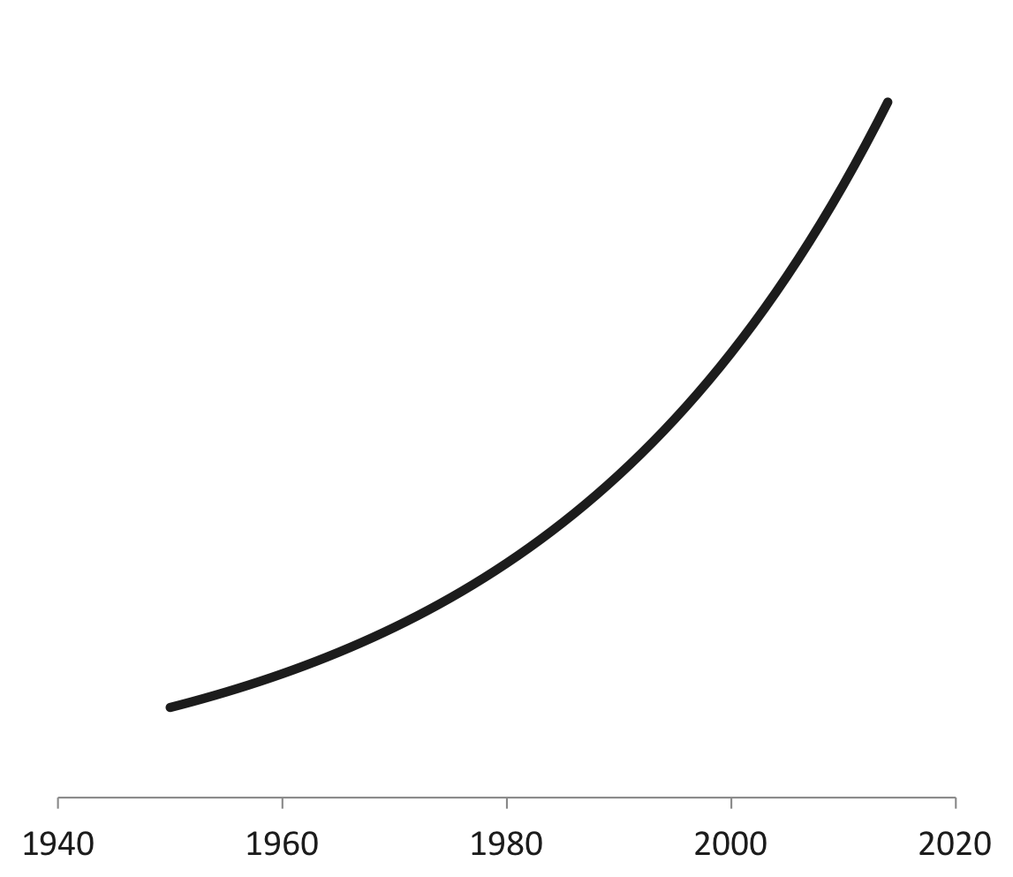
Today, annually ≈
>2.0 million scientific publications
3% annual growth

Slide 3
Re-think
1. the practice and problems of research
2. the dominant system of Incentives and Rewards
3. the ‘different’ underlying ideas (ideologies) about Science, Research and Academia.
Design, try evaluate interventions
Transition to Open Science:
why and how?

Slide 4
Just some of the problems of the science system
Transition to Open Science: why?
Competitive and non-cooperative practices
Quality and Replication crisis
Expensive commercial publication markets
Privatization and problems of knowledge ownership / knowledge access
Relationship with society
Katja Mayer (@katja_mat)

Slide 5
Science and some of its Problems
Novelty and quantity are dominant over quality, replication, relevance and impact
Short-termism and risk aversion because of 4-year funding cycles
Fields with high societal impact, but low impact in the metrics system suffer (applied vs basic; SSH vs STEM)
The national and institutional research agenda is thus not properly reflecting societal (clinical) needs and disease burden

Slide 6
The classical image of science distorts academia through flawed academic hierarchies
Natural and biomedical science >> Social science >> humanities (‘physics envy’)
2. Theoretical & pure science >> applied science and technology
Curiosity-driven research is the best for solving societal problems (the linear model)
Science should be autonomous, not interfered by external publics or politics and their problems
Scientific knowledge is neutral; scientists are not responsible for the knowledge they (don’t) produce

Slide 7
The Scientific Field: Professional Interests, Elites, Stratification, Power Struggle, and Economics
‘
Volkskrant
Pierre Bourdieu, 1975 & 2004, Latour and Woolgar 1979

Slide 8
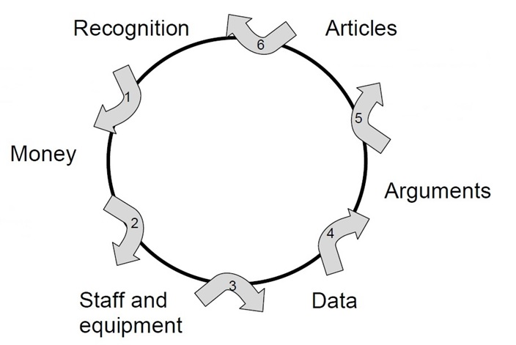
Problems of the Current Reward System in Science
Society is largely absent from the
credibility cycle
Quality in Quantitative terms: - number of articles, journal impact factor, citations, H-index
- amount of funding obtained
Hypercompetition for limited funds
Too little room for
Team-Science, Multidisciplinarity & Diversity
Most papers still behind paywalls
Data not shared
Notes:
Background:
there are ever more scientists
Institutions translate societal call for accountability into targets/deliverables/output measures for individual researchers
Understandable response to rankings, internationalization, increase in number of scientists/hypercompetition for funding
Historisch nog wel relevant om te realiseren dat het denken in output wel een reactie is op politiek/maatschappij die sinds jaren 70/80 vraagt om concrete opbrengsten van wetenschappelijk onderzoek dat gedaan is met belastinggeld

Slide 9
Re-think
1. the practice and problems of research
2. the dominant system of Incentives and Rewards
3. the ‘different’ ideas (ideologies) about Science, Research and Academia.
Design and try interventions!
Transition to Open Science:
why and how?

Slide 10
Open Science: the promise (1)
The overall aim of Open Science is to increase the quality, progress and scientific & societal impact of research and scholarship.
To achieve these goals in the practice of Open Science
Engage -when appropriate- with relevant and representative stakeholders from society to:
Define problems to be investigated; discuss ongoing research
Actively promote that the results of any kind provide guidance for implementation and action(s) in the specific contexts.
Notes:
Background:
there are ever more scientists
Institutions translate societal call for accountability into targets/deliverables/output measures for individual researchers
Understandable response to rankings, internationalization, increase in number of scientists/hypercompetition for funding
Historisch nog wel relevant om te realiseren dat het denken in output wel een reactie is op politiek/maatschappij die sinds jaren 70/80 vraagt om concrete opbrengsten van wetenschappelijk onderzoek dat gedaan is met belastinggeld

Slide 11
Open Science: the promise (2)
To achieve these goals in the practice of Open Science
Share research results, if possible, in several stages of the work and publishing these papers Open Access
And if possible Data and Code (Software) Open Access
Change Incentive and Rewards accordingly
Notes:
Background:
there are ever more scientists
Institutions translate societal call for accountability into targets/deliverables/output measures for individual researchers
Understandable response to rankings, internationalization, increase in number of scientists/hypercompetition for funding
Historisch nog wel relevant om te realiseren dat het denken in output wel een reactie is op politiek/maatschappij die sinds jaren 70/80 vraagt om concrete opbrengsten van wetenschappelijk onderzoek dat gedaan is met belastinggeld

Slide 12

European Open Science Agenda 2016
Rewards and Incentives
Research Indicators and Next-Generation Metric
OA and the Future of Scholarly Communication
European Open Science Cloud
FAIR Data
Research Integrity
Skills and Education
Citizen Science/Public Engagement
https://www.openscience.eu/open-science-policy-platform-final-report/
Notes:
EU Open Science Roadmap

Slide 13
Utrecht University
Open Science Programme
2017 Writing of the OS Programme 2018-2022
2019, Jan. start of the UU OS project team
2019 Start of the 4 teams of the tracks
2020 Start of the Faculty OS Teams
2021, Jan. Recognition and Rewards Vision paper
2021 April, first draft of the 2022-2025 Program

Slide 14
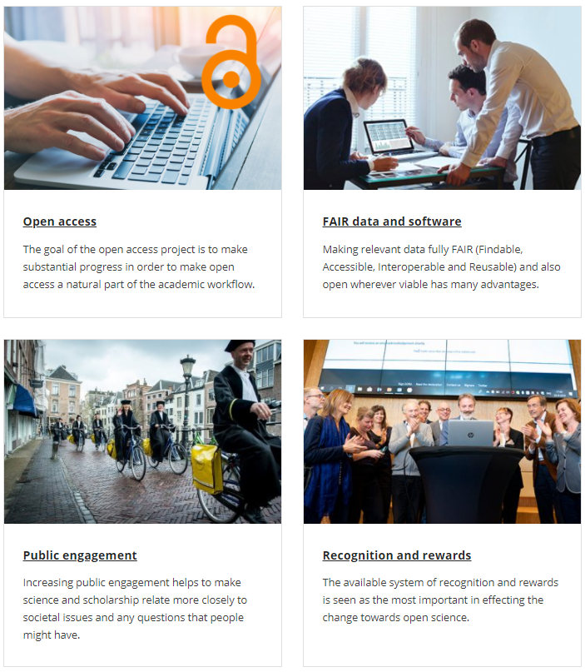
Notes:
Vooral gebruiken maken van het plaatje om structuur in bijv werkgroepen aan te geven die aan verschillende actielijnen werken.

Slide 15
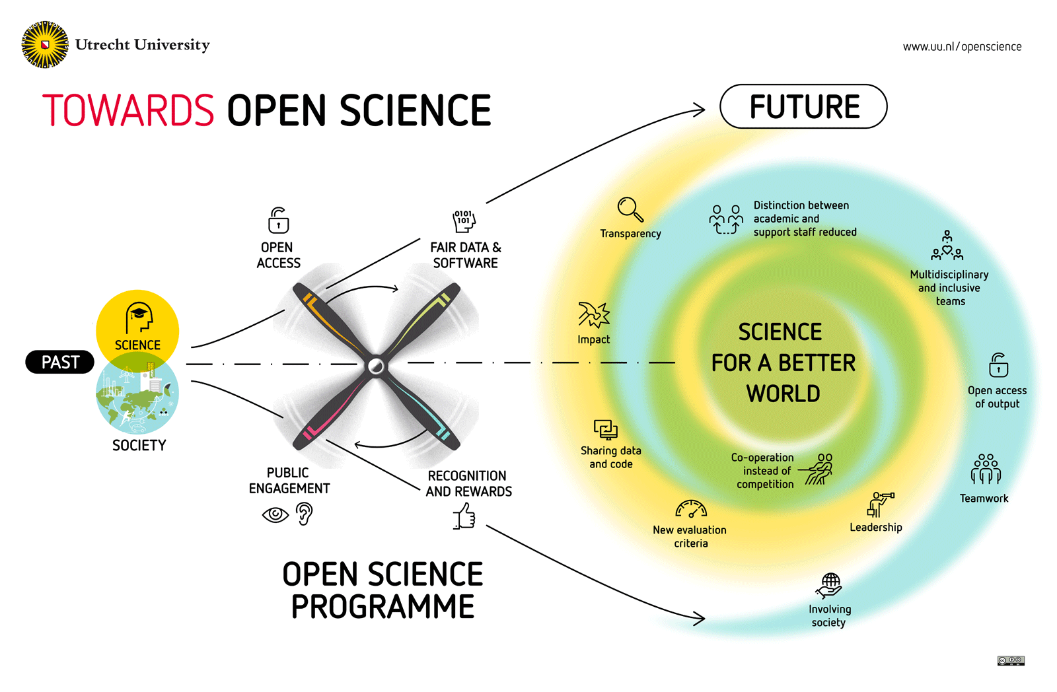
Notes:
Hier overkoepelend doel/aanleiding. Subdoelen. Eventueel illustratie. Info zo recent mogelijk. Begeleidende tekst zou kunnen zijn: Utrecht University wants to promote open science as part of its promise to make science more open and even more reliable, efficient and relevant to society.
Utrecht University aims to be at the forefront of open science. Therefore, the Executive Board has launched the Utrecht University Open Science Programme.
This programme aims to stimulate and facilitate researchers to put open science into practice.

Slide 16
Notes:
Vooral gebruiken maken van het plaatje om structuur in bijv werkgroepen aan te geven die aan verschillende actielijnen werken.

Slide 17
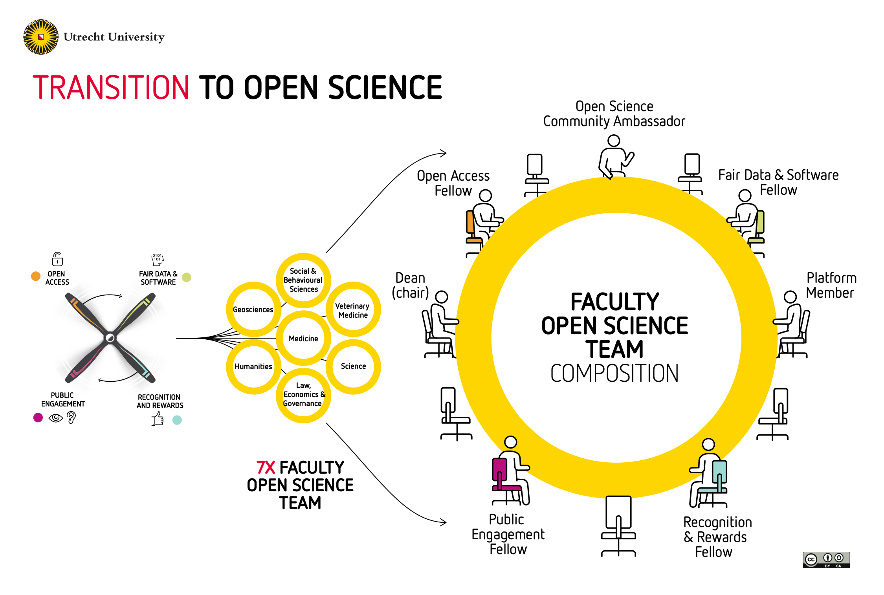
Notes:
Vooral gebruiken maken van het plaatje om structuur in bijv werkgroepen aan te geven die aan verschillende actielijnen werken.

Slide 18
@UMCUTRECHT: Inclusive set of generic indicators for research quality and impact (in use since 2016)
Structure | Leadership & culture
 | Collaborations with stakeholders
 | Continuity and infrastructure
Process | Setting research priorities
 | Posing the right questions
 | Incorporation of next steps
 | Design, conduct, analysis
 | Regulation and management (OA, FAIR data sharing)
Outcomes | Research products for peers
 | Research products for societal groups
 | Use of research products by peers
 | Use of research products by societal groups
 | Marks of recognition from peers
 | Marks of recognition from societal groups
https://www.umcutrecht.nl/en/science-in-transition

Slide 19
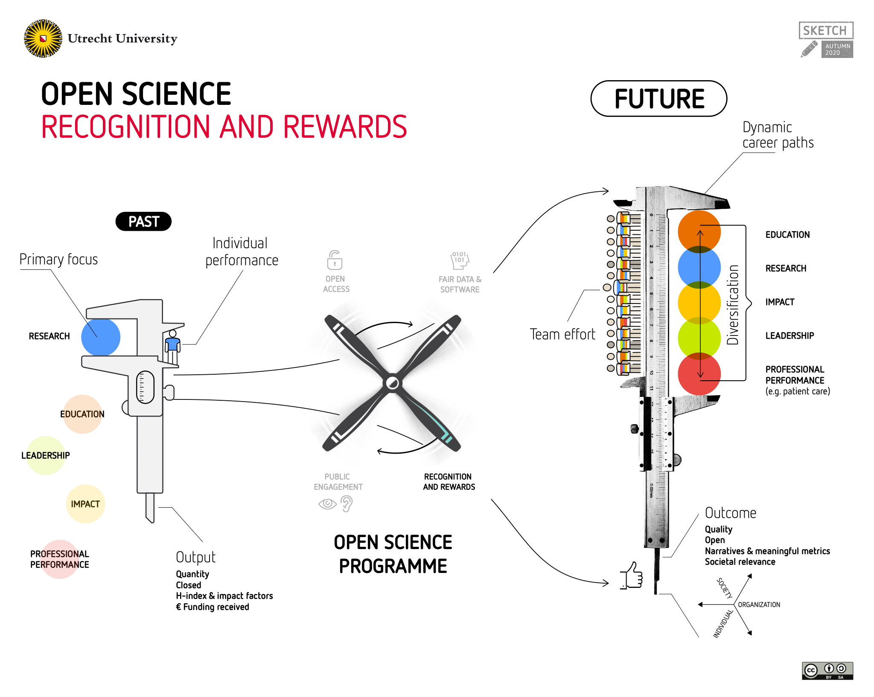
Notes:
Hier overkoepelend doel/aanleiding. Subdoelen. Eventueel illustratie. Info zo recent mogelijk. Begeleidende tekst zou kunnen zijn: Utrecht University wants to promote open science as part of its promise to make science more open and even more reliable, efficient and relevant to society.
Utrecht University aims to be at the forefront of open science. Therefore, the Executive Board has launched the Utrecht University Open Science Programme.
This programme aims to stimulate and facilitate researchers to put open science into practice.

Slide 20
Systemic Interventions to improve quality, impact and integrity at all levels
Engagement of societal stakeholders in problem choice research and evaluation
Inclusive indicators
Quality
Societal Impact
Use in and outside academia
Process Indicators
OPEN PEER REVIEW
POST PUB PEER REVIEW
OA publishing
FAIR data sharing
Notes:
Background:
there are ever more scientists
Institutions translate societal call for accountability into targets/deliverables/output measures for individual researchers
Understandable response to rankings, internationalization, increase in number of scientists/hypercompetition for funding
Historisch nog wel relevant om te realiseren dat het denken in output wel een reactie is op politiek/maatschappij die sinds jaren 70/80 vraagt om concrete opbrengsten van wetenschappelijk onderzoek dat gedaan is met belastinggeld

Slide 21
Open Science will:
At the organizational level improve academic culture and the daily practice of research
Foster responsible research conduct and research integrity at several levels
Will improve the interaction with society and increase the impact of science
The Promise of Open Science

Slide 22
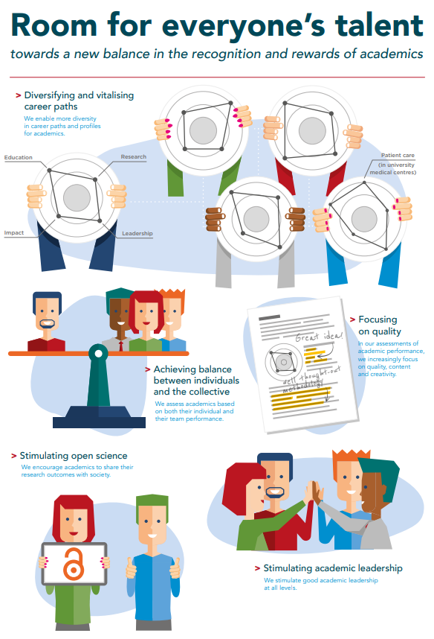
https://www.vsnu.nl/recognitionandrewards/wp-content/uploads/2019/11/
Position-paper-Room-for-everyone%E2%80%99s-talent.pdf

